Slide 1
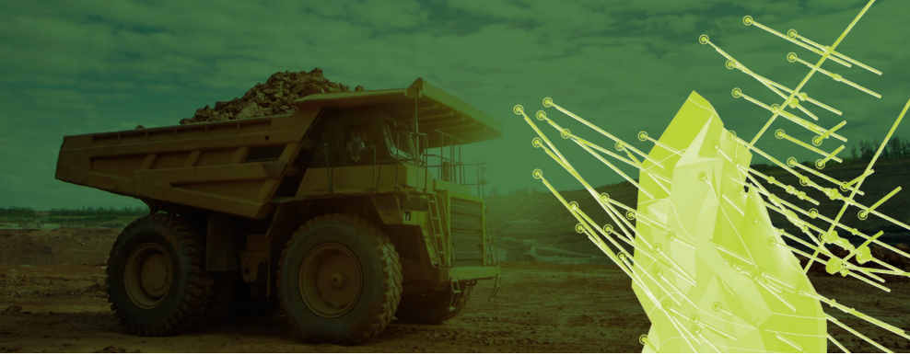
COMPOSITION OF EXPLORATION WELLS FOR RESOURCE MODELLING (ORE GOLD DEPOSIT)

Slide 2
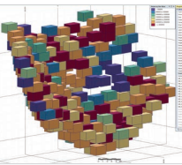
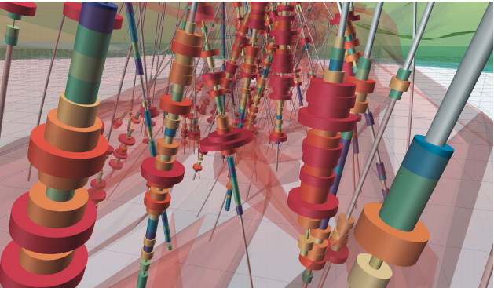
Summary
The development of mineral deposits (MPI) is preceded by the creation of a three-dimensional model of the deposit. In the case of ore gold, this is a block model of the ore body (gold is in the ore).
This model allows obtaining information about solid minerals reserves. It also helps us to choose one or another way to develop this mine.

Slide 3
Problem Statement
The deposit model is built according to the specified parameters in specialized software - mining and geological information systems. To create a field model, it is necessary to prepare a database. which describes the following key entities:
coordinates of wellheads (the wellhead is the drilling point on the surface);
data on the curvature of wells in the form of measurements of the angle of inclination and Azimuth at points along the well trajectory;
assay data in the selected samples from wells.
Within the framework of this project, we will consider a task directly related to the preparation of a well database (further)

Slide 4
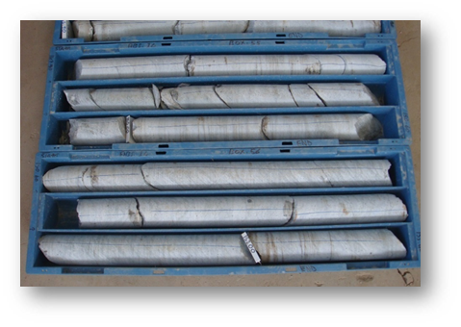
Exploration wells are drilled at the field with core sampling.These processes are outsourced.Every day, files of the approved format come to us from different areas of the fields (an example of the file will be added ..)
Problem
incoming files may contain errors in the data: possible intersections of intervals, etc.
Sub-task 1
When data arrives, it must be checked for errors and then automatically corrected. Thus, we improve the quality of the information on which our model will be built.

Slide 5
The core extracted from the wells is marked for samples and sent (by outsourcers) to the laboratory for analysis.From the laboratory, we receive protocol files on the contents in the samples (an example will be added ...)
Sub-task 2
We need to aggregate the incoming data into a separate table, and then perform the task of compositing (combining ordinary samples into larger intervals based on specified criteria: the minimum content of a useful component, the minimum length of a new ore interval, etc.).
The use of composites will help to correctly form the gold ore body in 3D and help in building the model.

Slide 6
SOLUTION
Our development allows us to solve the following tasks:
validation of sampling intervals with automatic correction of errors in the intervals;
- building composites for exploration wells as a stage of creating a database of wells for subsequent modeling in specialized software
https://github.com/mmingalov/geekbrains-final-project

Slide 7
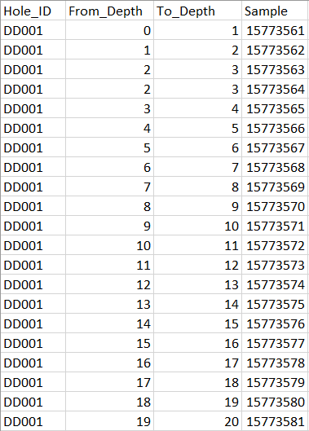
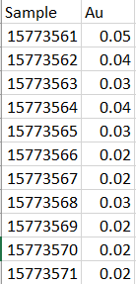
Source files
Numbers of geological samples taken during drilling and sent to the laboratory for analysis of the gold content.
Numbers of geological samples with gold content identified by the laboratory. Come in a few days after the analysis.

Slide 8
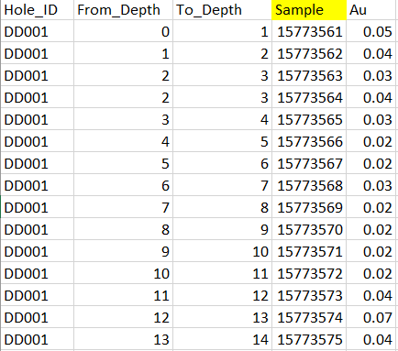
Merging of source files
To calculate composites, it is necessary to combine files through the INNER JOIN operation using the Sample field (sample identifier)The result of the combination in the picture on the right:

Slide 9
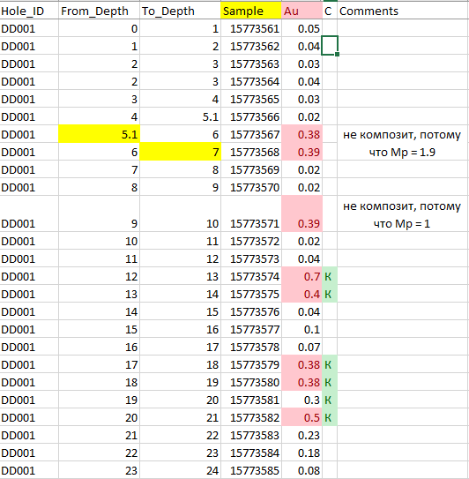
Compositing example
An ore interval (composite) is an interval along the line of geological sampling, consisting of elementary ordinary samples and satisfying certain conditions for selection.
The following condition parameters are usually used to calculate and identify ore intervals at the stage of reserves calculation:
onboard content of the useful component Сб;
minimum thickness of the ore body Мр
Condition parameters in the example on the right:
Сб = 0.37
Мр = 2
К -- composite

Slide 10


Data flow
HDFS
(partitions by days)
table with accumulated data for all partitions
CSV
(drilling data)
final table
for compositing
COMPOSITING CALCULATION
Result table
JOIN hive-tables by Sample
CSV
(composites)
CSV
(assay data)
HDFS
(partitions by days)
table with accumulated data for all partitions
CSV
CSV
Spark DF
Spark DF
Spark DF
CSV
Notes:
drilling data are received once a day
assay data are received once a day. By the time they arrive, there are guaranteed to have the appropriated rilling data. You can do JOIN

Slide 11
Development cost
We will take 15 working days to complete the task by one specialist. This will include the steps:
architecture design, setting up data sources (3 days)
testing the data collection process (5 days)
programming (2 days)
functional testing and debugging of the solution (5 days)
If you work in the 8-hour working day at a rate of 10 US dollars per hour, wages, together with tax deductions, will be:15 * 8 * 10$ * 1.43 = 1716$
Equals to 128 700 RUR (1USD = 75RUR)

Slide 12
Economical effect
Prior to solving the problem, the process of calculating composites was carried out in a semi-automatic mode, when the specialist was forced to manually collect daily data from files, join them into the final register and calculate composites in Excel.
Due to manual operations, additional geologist time was wasted, which could be directed to other tasks.
The geologist spent up to 30 hours a month on this work.
The development of our solution took 120 hours (see previous slide).With approximately the same wage rates for the developer and the geologist, we come to the conclusion that the payback of the development comes already in the 5th month.
Further, we have the following economic effect from the implementation:
30ч * 10$ * 1.43 = 429$ = 32 175 RUR (monthly)
5148$ = 386 100 RUR (yearly)

